Slide 1
Match Prediction: AI Football Analytics
From Historical Data to Intelligent Decision Making
------------------------------------------------
Presented by: Apex Zenith Team

Slide 2
1. Goals of the Solution
Create a data‑driven football match prediction system
Enable intelligent, explainable probability outputs
Build a scalable architecture for rapid experimentation
Support automated feature engineering and model tuning

Slide 3
2. How We Approached the Problem
Started with understanding core uncertainty in football
Focused on building time‑aware features
Performed strict time‑series validation
Chose stacking ensemble for robustness
Iteratively improved based on model insights

Slide 4
3. Solution Architecture
Data ingestion pipeline
Feature engineering module
Dynamic Elo subsystem
Stacking ensemble prediction engine
Demo application layer

Slide 5
4. Key Components
Elo rating updates after each match
Rolling windows for recent form
Odds‑derived implied probabilities
30+ dimensional automatic extraction

Slide 6
5. Key Logic: Dynamic Elo Algorithm
Expected Probability = logistic(home_elo, away_elo)
Updated Ratings = old + K × (actual − expected)
Captures dynamic strength changes

Slide 7
6. Key Logic: Stacking Ensemble
Base Models: Logistic Regression, Random Forest, XGBoost
Meta Model: Logistic Regression
Cross‑validated stacking to avoid leakage

Slide 8
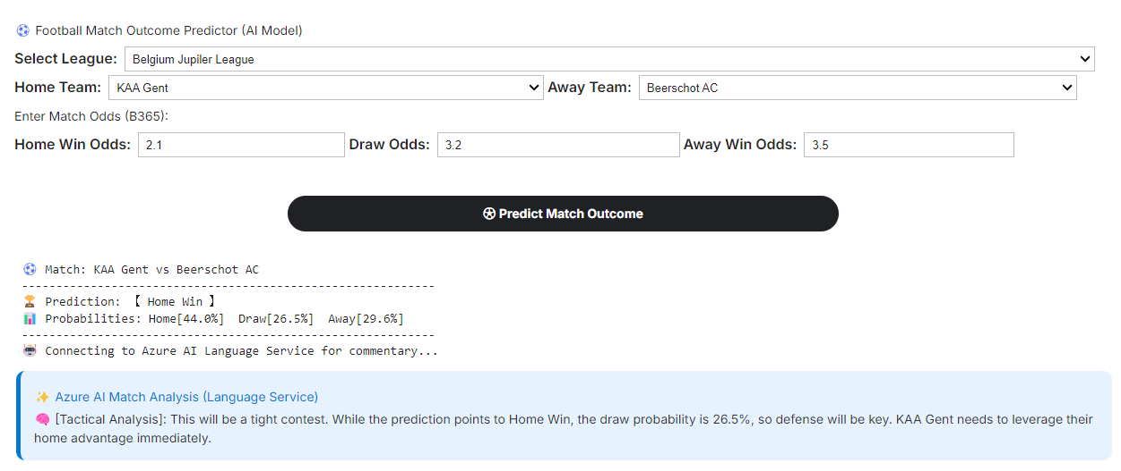
7. Application Demo
Interactive Features:
1. Smart League Filtering
2. Auto Feature Extraction
(Retrieving 30+ dims)
3. Probability Output
(Home / Draw / Away)
4. Value Detection
(Model vs. Market Odds)
5. Azure Language Service

Slide 9
8. Key Learnings
Elo + Odds provided strongest predictive power
Market odds encode vital sentiment
Time‑series validation is mandatory
Ensemble models outperform single models

Slide 10
9. Roadmap
Kelly‑based value betting engine
LSTM/RNN for sequential trends
Real‑time API for in‑play predictions
SHAP‑based explainability

Slide 11
THANK YOU

